Slide 1

Serverless Application Model (SAM)
Simplifying Serverless Development

Slide 2

What is AWS SAM?
Open-Source Framework
YAML-Based Configuration
AWS Service Integration
For building serverless applications.
Simplifies defining and deploying AWS resources.
Works with Lambda, API Gateway, DynamoDB, and more.

Slide 3




Why Use AWS SAM?
Simplified Infrastructure
Faster Development
Built-in AWS Support
Infrastructure as Code using YAML.
Local testing with SAM CLI.
API Gateway, DynamoDB, S3, etc.

Slide 4





AWS SAM Architecture
AWS Lambda
Serverless compute service
Amazon API Gateway
Manages API requests
Amazon DynamoDB/S3
Stores application data
Event Sources
S3, SNS, SQS, CloudWatch triggers Lambda

Slide 5
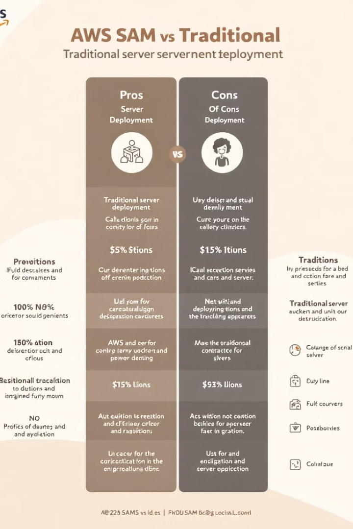
SAM vs Traditional Deployment
Feature
Traditional Server Deployment
AWS SAM
Server Management
Required
Not needed
Scaling
Manual
Automatic
Cost
Pay for uptime
Pay-per-use
CI/CD Integration
Complex
Simplified

Slide 6

AWS SAM CLI
1
Test Lambda Locally
2
Build & Deploy
sam local invoke MyFunction
sam build; sam deploy --guided
3
Start a Local API
sam local start-api

Slide 7

Use Cases of AWS SAM
Web & Mobile Backends
Serverless REST APIs
Data Processing
Trigger-based processing with Lambda & S3
IoT Applications
Event-driven automation
Chatbots & AI Services
Voice and text-based applications

Slide 8
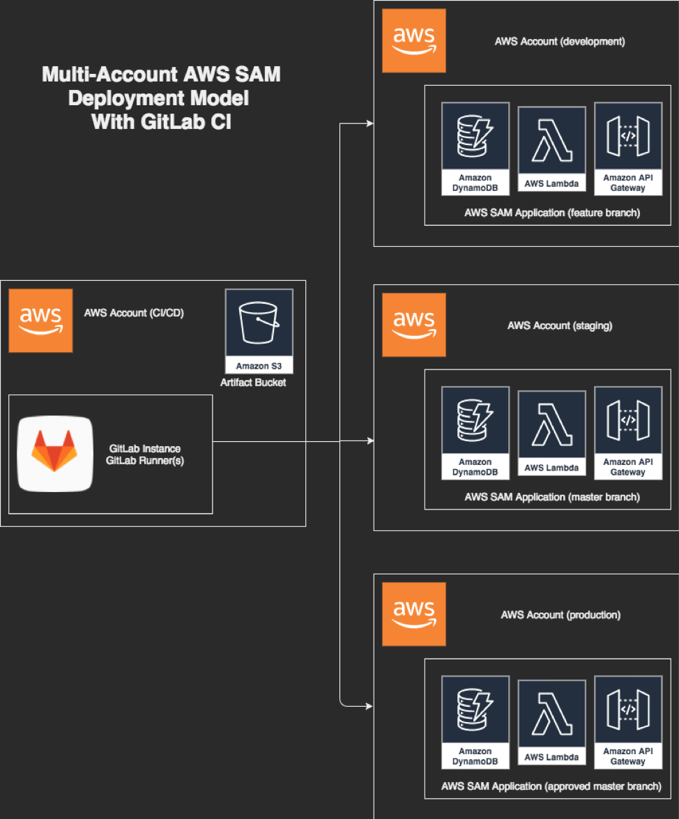

AWS SAM Workflow – How It Works?
Step 1: Define the application
Create a template.yaml file with all the required AWS services (Lambda, API Gateway,
DynamoDB, etc.).
Step 2: Build and test locally
Run sam build to package the app.
Use sam local start-api to test the API before deploying.
Step 3: Deploy to AWS
Use sam deploy --guided to deploy your application.
AWS SAM automatically creates and manages AWS CloudFormation
stacks behind the scenes.
Step 4: Monitor and manage
Use sam logs to check logs from CloudWatch.
Use sam delete if you need to remove the deployed resources.
This Photo by Unknown Author is licensed under CC BY-SA

Slide 9
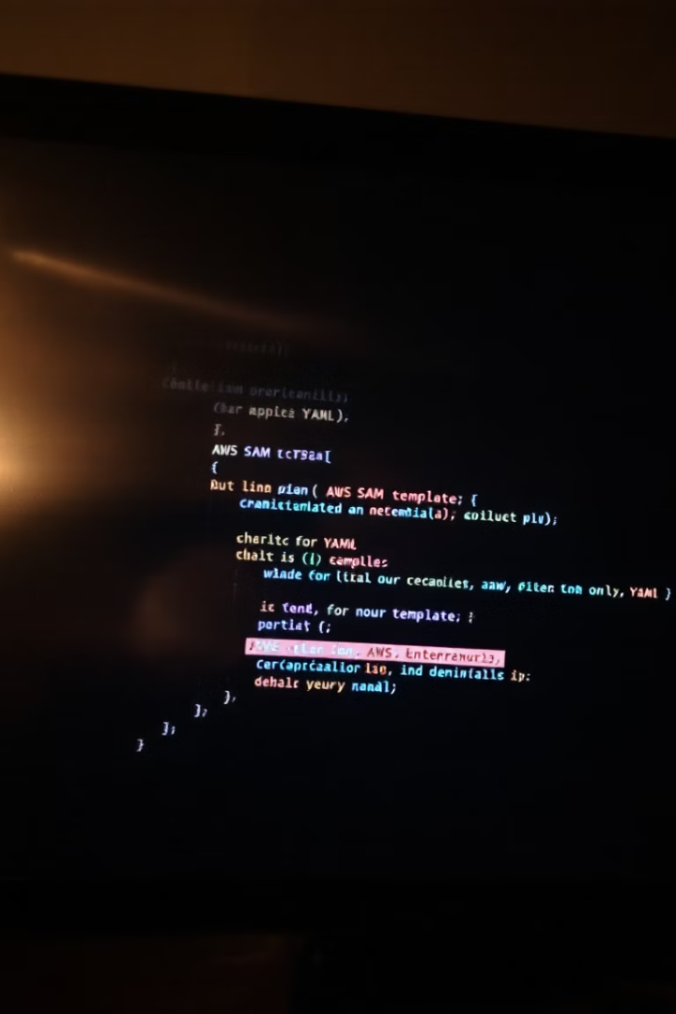
AWS SAM Template (Example)
AWSTemplateFormatVersion: '2010-09-09'
Transform: AWS::Serverless-2016-10-31
Resources:
MyFunction:
Type: AWS::Serverless::Function
Properties:
Runtime: nodejs18.x
Handler: index.handler
Events:
ApiEvent:
Type: Api
Properties:
Path: /hello
Method: get

Slide 10
Conclusion
1
Simplifies Development
AWS SAM streamlines serverless app creation.
2
Cost-Effective
Scalable, efficient for cloud-native apps.
3
Ideal for Modern Apps
High availability and auto-scaling.

Slide 11

Q&A
Thank you for your time!
Questions?

